Slide 1

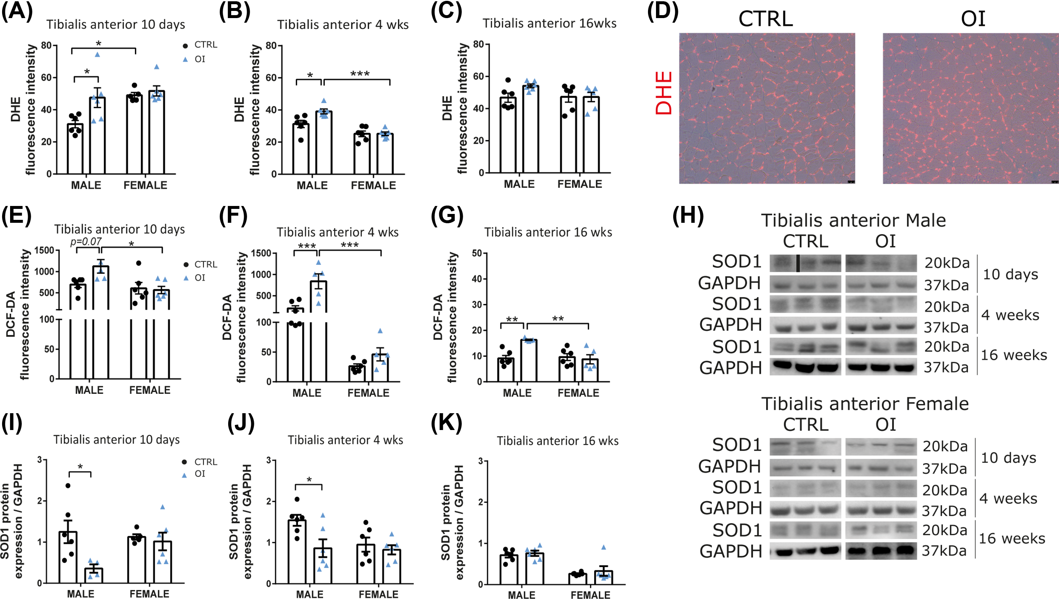
Clin Sci (Lond) Volume 135 Issue 22 2021 2589-2605 10.1042/CS20210894
Figure 1
Transient neonatal exposure to hyperoxia, an experimental model of preterm birth, leads to skeletal muscle atrophy and fiber type switching
The content of this slide may be subject to copyright: please see the slide notes for details
Notes:
Figure Caption:
Oxidative stress and antioxidant defenses(A–C) Quantification of DHE staining of TA sections and (E–G) of DCF-DA fluorescence intensity in TA muscle homogenate from 10 days, 4 and 16 weeks (wks) old room air control (CTRL) vs neonatal oxygen-induced injury (OI) male and female rats. (D) Representative images of DHE staining of TA from CTRL and OI 4-week-old male rats. (H) Representative images of Western blots showing the protein expression of SOD1 and GAPDH (as loading control) in TA from 4 and 16 wks old CTRL vs OI male and female rats. All samples from a specific time point and sex were processed on the same gel/blot. Black bar delineates samples that are not next to each other on the same blot. (I–K) Protein expression of SOD1 (relative to GAPDH) in TA from 10 days, 4 and 16 wks old CTRL vs OI males and females. Error bars represent means ± SEM; n=5–6 per group. Scale bars = 25 µm. Statistical analyses were performed using two-way ANOVA with Tukey’s post-test, *P<0.05; **P<0.01; ***P<0.001 vs group indicated.
Unless stated otherwise in the caption above, the following copyright applies to the content of this slide: © 2021 The Author(s). Published by Portland Press Limited on behalf of the Biochemical Society2021

Slide 2
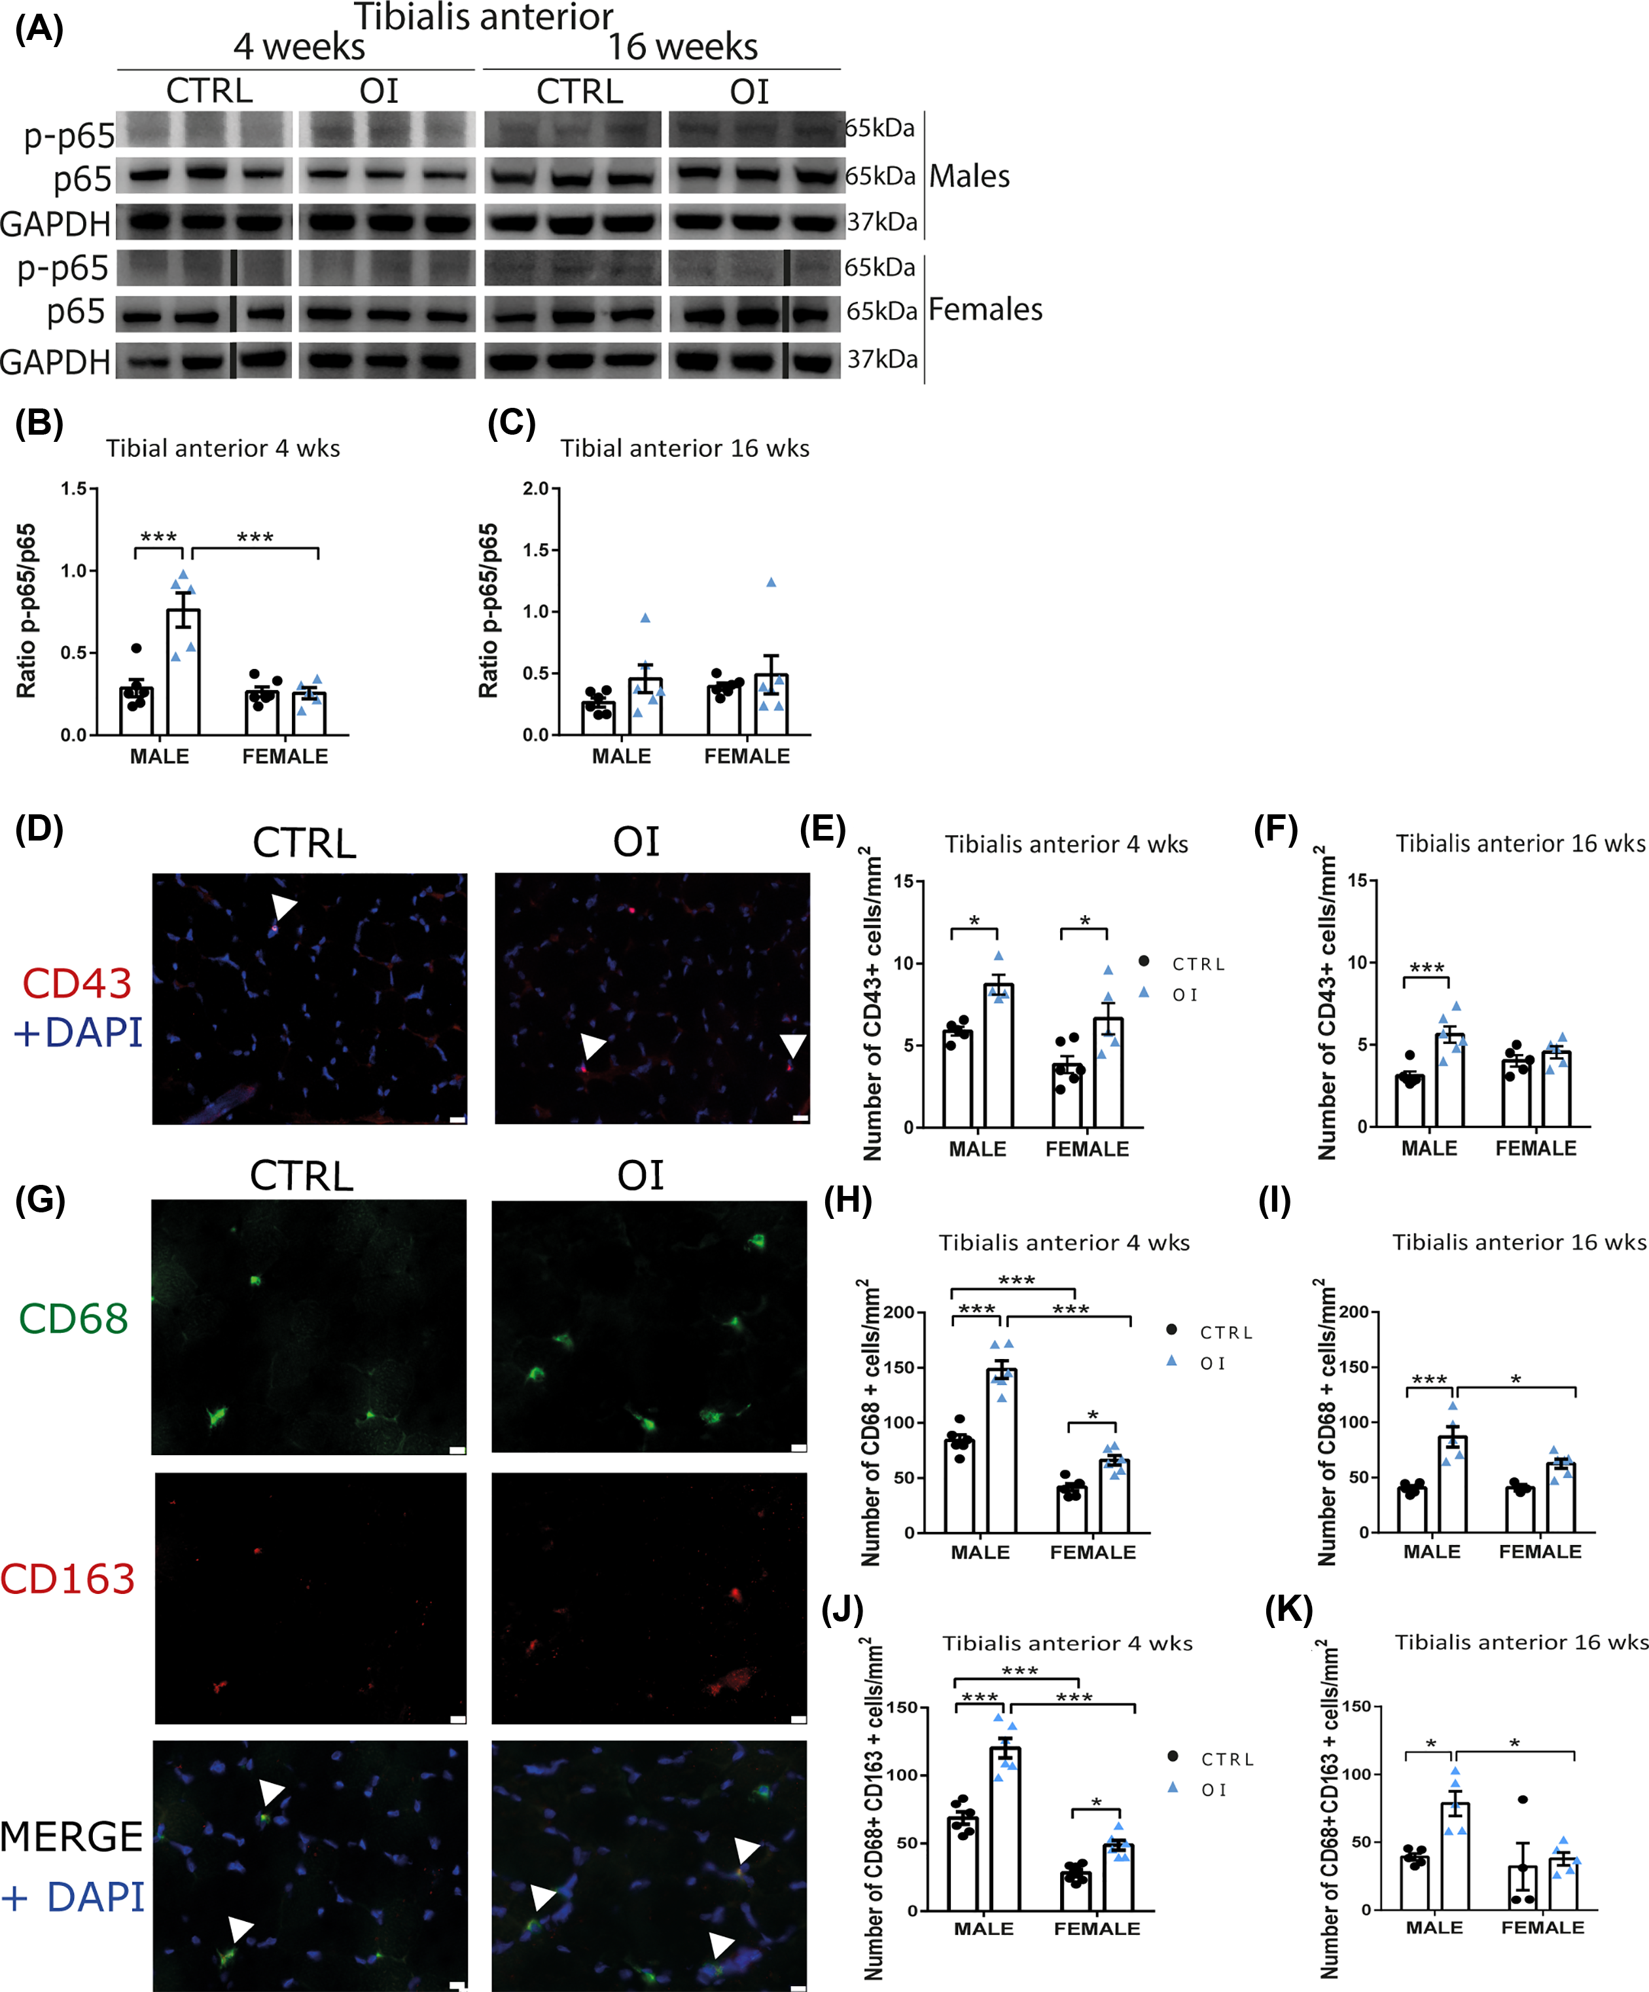
Clin Sci (Lond) Volume 135 Issue 22 2021 2589-2605 10.1042/CS20210894
Figure 2
Transient neonatal exposure to hyperoxia, an experimental model of preterm birth, leads to skeletal muscle atrophy and fiber type switching
The content of this slide may be subject to copyright: please see the slide notes for details
Notes:
Figure Caption:
NF-κB and inflammatory cell infiltration(A) Representative images of Western blots showing the protein expression of phospo-p65 (p-p65), p65, and GAPDH (as loading control) in the TA from 4 and 16 weeks (wks) old room air control (CTRL) and neonatal oxygen-induced injury (OI) male and female rats. All samples from a specific time point and sex were processed on the same gel/blot. Black bars delineate samples that were not next to each other on the same blot. (B,C) Ratio of relative protein expression of p-p65/p65 in TA from 4 and 16 wks old CTRL vs OI males and females. (D) Representative micrographs of immunostaining for CD43 (neutrophil marker, red) and DAPI (nuclei marker, blue). (E,F) Quantification of CD43<sup>+</sup> cells per mm<sup>2</sup> in TA sections from 4 and 16 wks old CTRL vs OI male and female rats. (G) Representative micrographs of immunostaining for CD68 (pan-macrophage marker, green) and CD163 (resident macrophage marker, red) and merge (CD68, CD163, and DAPI) on TA sections from 4-week-old CTRL and OI male rats. Quantification of the number of CD68<sup>+</sup> (H,I), and double positive CD68<sup>+</sup> and CD163<sup>+</sup> (J,K) cells per mm<sup>2</sup> in TA sections from 4 and 16 wks old CTRL vs OI male and female rats. Error bars represent means ± SEM; n=5–6 per group. Scale bars = 10 µm for CD68<sup>+</sup> and CD163<sup>+</sup> staining, and 25 µm for CD43. Statistical analyses were performed using two-way ANOVA with Tukey’s post-test. *P<0.05; ***P<0.001 vs group indicated.
Unless stated otherwise in the caption above, the following copyright applies to the content of this slide: © 2021 The Author(s). Published by Portland Press Limited on behalf of the Biochemical Society2021

Slide 3
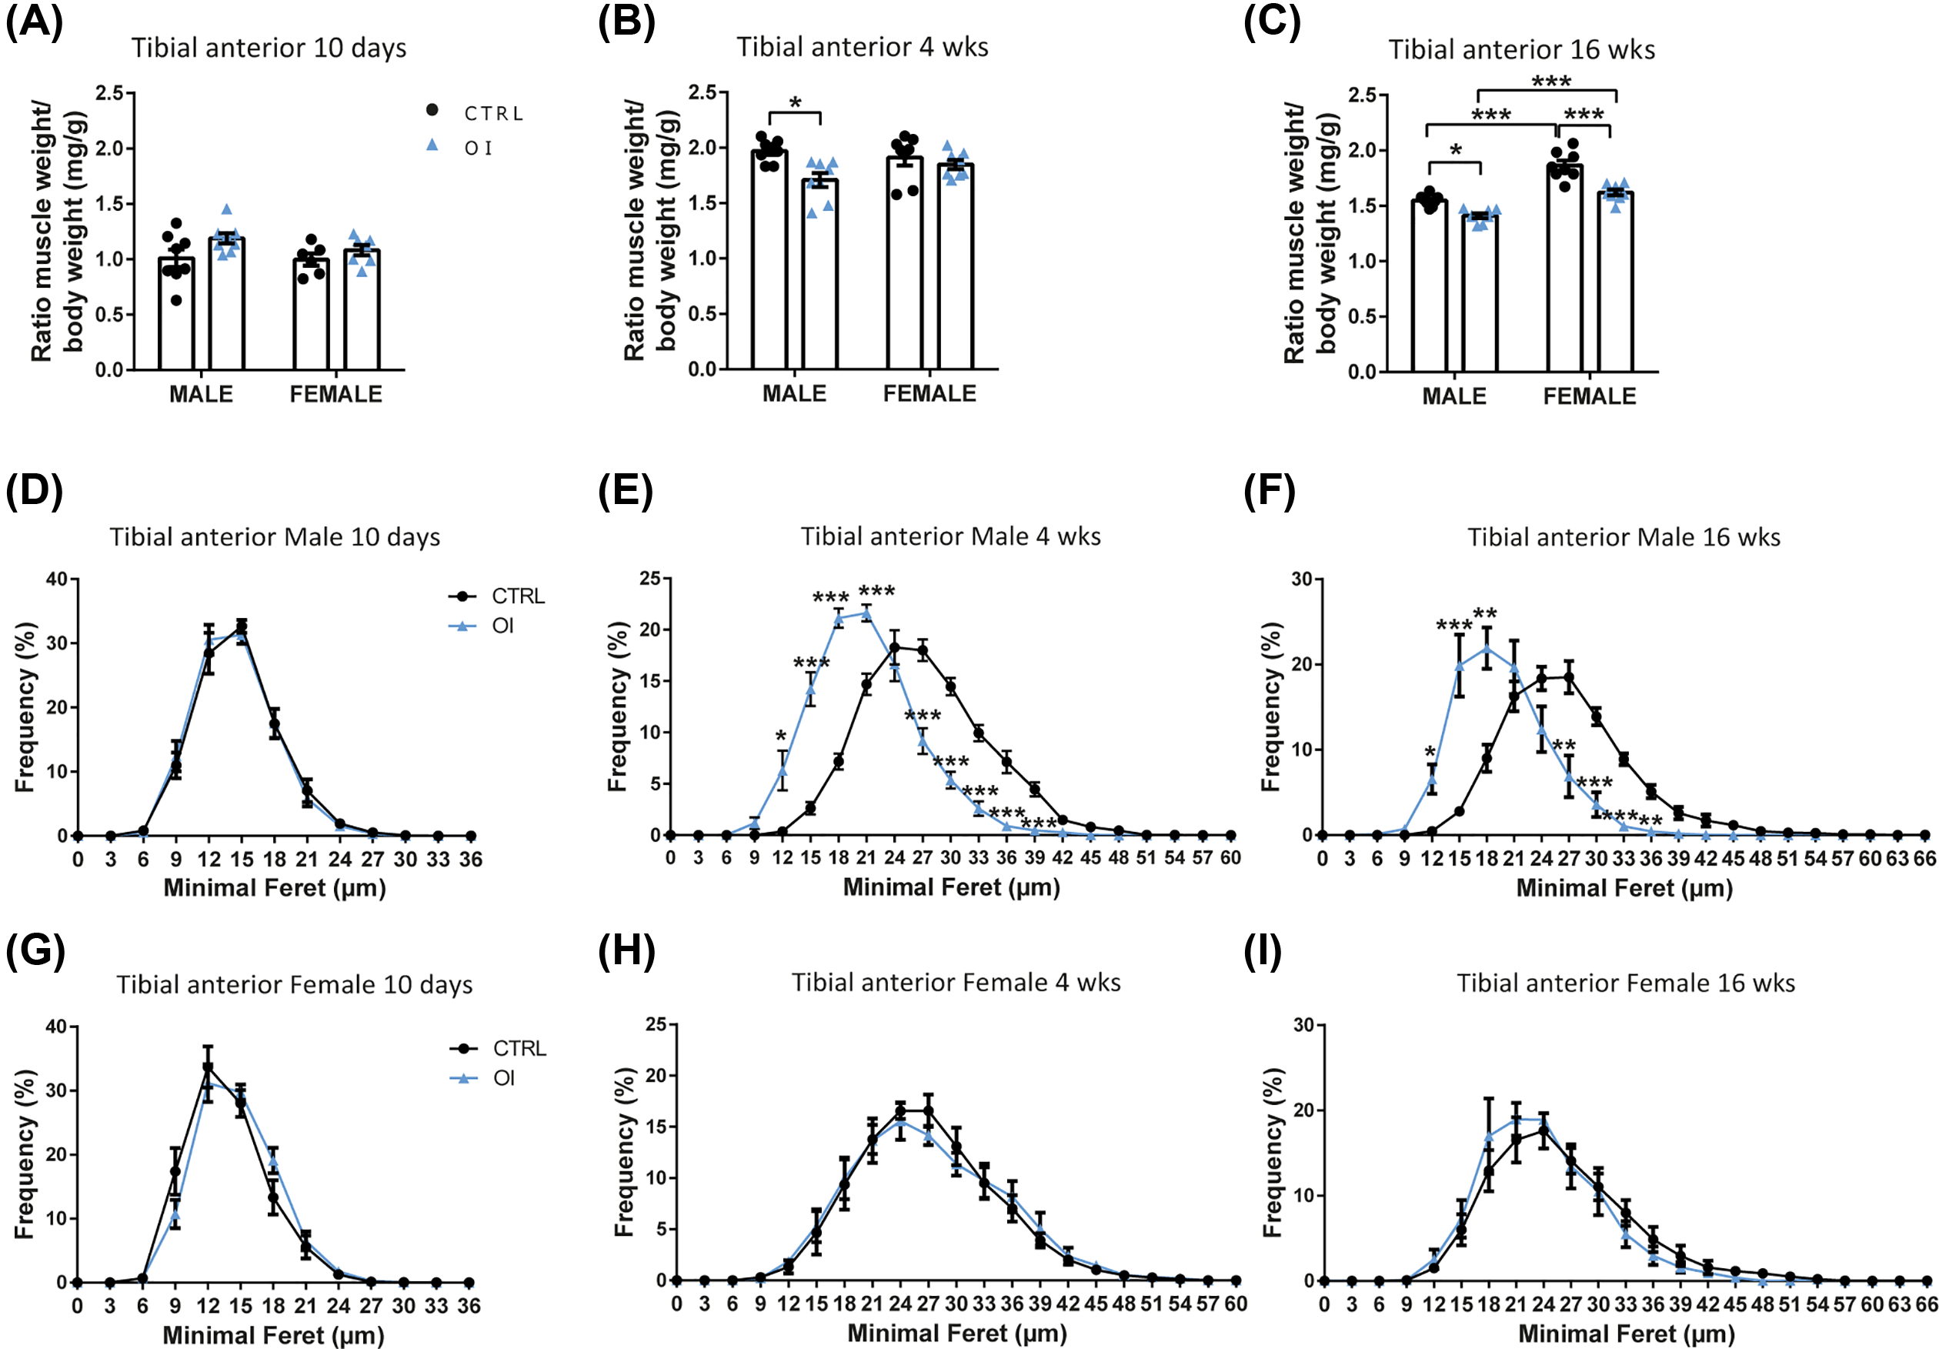
Clin Sci (Lond) Volume 135 Issue 22 2021 2589-2605 10.1042/CS20210894
Figure 3
Transient neonatal exposure to hyperoxia, an experimental model of preterm birth, leads to skeletal muscle atrophy and fiber type switching
The content of this slide may be subject to copyright: please see the slide notes for details
Notes:
Figure Caption:
Muscle mass and fiber size(A–C) Muscle weight to body weight ratio for the TA from 10 days, 4 and 16 weeks (wks) room air control (CTRL) vs neonatal oxygen-induced injury (OI) male and female rats. Evaluation of myofiber size with the minimal fiber feret (µm) in TA from 10 days, 4 and 16 wks old CTRL vs OI males (D–F) and females (G–I). Error bars represent means ± SEM; n=6–8 per group. Statistical analyses were performed using two-way ANOVA with Tukey’s post-test (A–C) or Student’s t tests (D–I). *P<0.05; **P<0.01; ***P<0.001 vs group indicated (A–C) or CTRL vs OI (D–I).
Unless stated otherwise in the caption above, the following copyright applies to the content of this slide: © 2021 The Author(s). Published by Portland Press Limited on behalf of the Biochemical Society2021

Slide 4
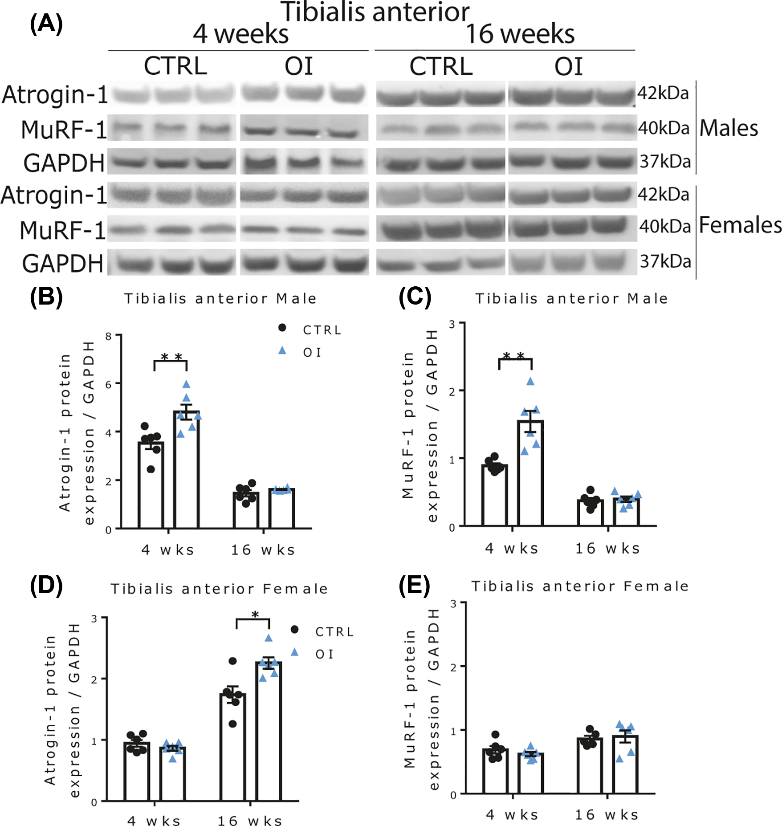
Clin Sci (Lond) Volume 135 Issue 22 2021 2589-2605 10.1042/CS20210894
Figure 4
Transient neonatal exposure to hyperoxia, an experimental model of preterm birth, leads to skeletal muscle atrophy and fiber type switching
The content of this slide may be subject to copyright: please see the slide notes for details
Notes:
Figure Caption:
Markers of protein degradation(A) Representative images of Western blots showing the protein expression of atrogin-1, MuRF-1, and GAPDH (as loading control) in TA. All samples from a specific time point and sex were processed on the same gel/blot. (B–E) Protein expression of atrogin-1 and MuRF-1 (relative to GAPDH) in TA from 4 and 16 weeks (wks) old room air control (CTRL) vs neonatal oxygen-induced injury (OI) male and female rats. Error bars represent means ± SEM; n=5–6 per group. Statistical analyses were performed using two-way ANOVA with Tukey’s post-test. *P<0.05; **P<0.01 vs group indicated.
Unless stated otherwise in the caption above, the following copyright applies to the content of this slide: © 2021 The Author(s). Published by Portland Press Limited on behalf of the Biochemical Society2021

Slide 5
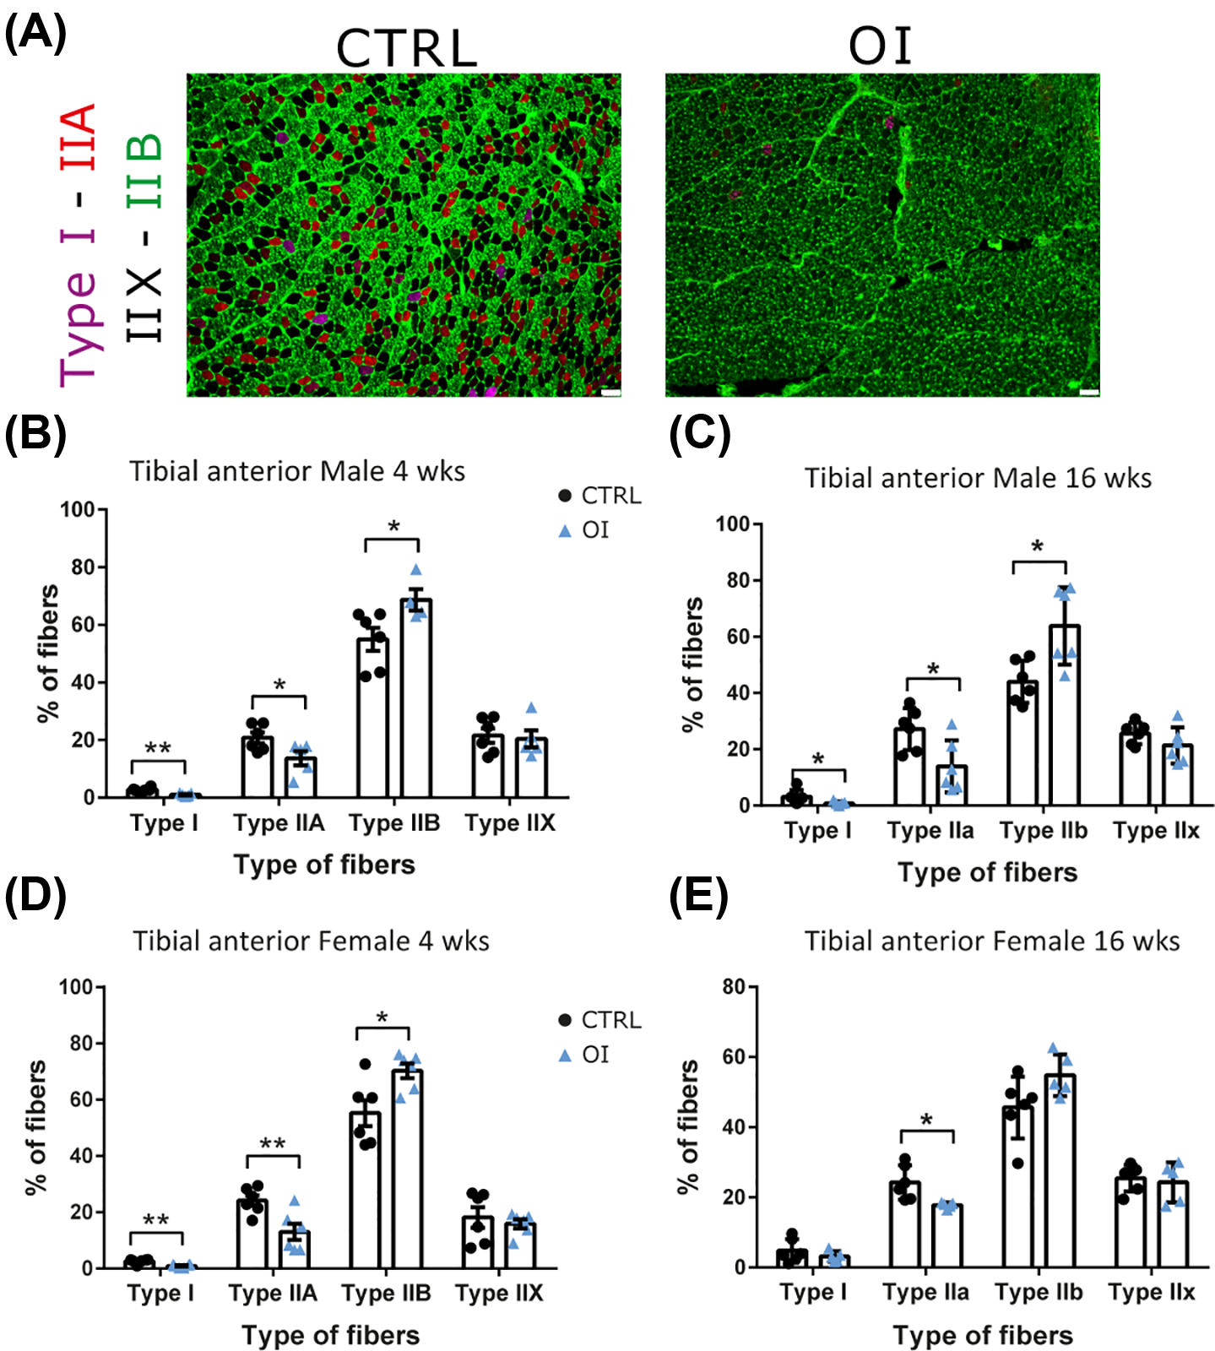
Clin Sci (Lond) Volume 135 Issue 22 2021 2589-2605 10.1042/CS20210894
Figure 5
Transient neonatal exposure to hyperoxia, an experimental model of preterm birth, leads to skeletal muscle atrophy and fiber type switching
The content of this slide may be subject to copyright: please see the slide notes for details
Notes:
Figure Caption:
Skeletal muscle fiber types(A) Representative micrographs of type I (purple), IIA (red), IIB (green), and IIX (black) MyHC immunostaining of the TA sections from 4 weeks (wks) old room air control (CTRL) and neonatal oxygen-induced injury (OI) male rats. Proportion of each fiber type in the TA from 4 and 16 wks old CTRL vs OI males (B,C) and females (D,E). Error bars represent means ± SEM; n=6 per group. Scale bars = 25 µm. Statistical analyses were performed using Student’s t test. *P<0.05; **P<0.01 vs group indicated.
Unless stated otherwise in the caption above, the following copyright applies to the content of this slide: © 2021 The Author(s). Published by Portland Press Limited on behalf of the Biochemical Society2021

Slide 6
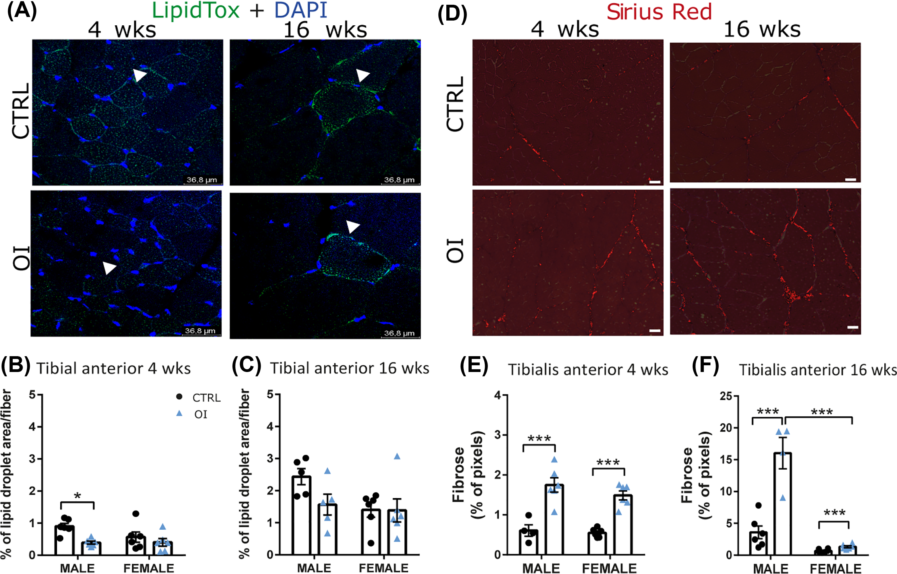
Clin Sci (Lond) Volume 135 Issue 22 2021 2589-2605 10.1042/CS20210894
Figure 6
Transient neonatal exposure to hyperoxia, an experimental model of preterm birth, leads to skeletal muscle atrophy and fiber type switching
The content of this slide may be subject to copyright: please see the slide notes for details
Notes:
Figure Caption:
Lipid deposition and fibrosis(A) Representative micrographs of lipidTox staining (neutral lipid marker, green) and DAPI (nuclei marker, blue) of TA sections from 4 and 16 weeks (wks) room air control (CTRL) and neonatal oxygen-induced injury (OI) male. White arrows identify muscle fibers positive for lipidTox staining. (B,C) Quantification of lipid droplet area per fiber (percentage of green pixels/area) of TA sections from 4 and 16 wks old CTRL vs OI males and females. (D) Representative micrographs of Sirius Red staining (collagen type I) TA sections from 4 and 16 wks old CTRL and OI males. (E,F) Quantification of Sirius Red staining (percentage of red pixels/area) of TA sections from 4 and 16 wks old CTRL vs OI males and females. Error bars represent means ± SEM; n=5–6 per group. Scale bars = 25 µm. Statistical analyses were performed using two-way ANOVA with Tukey’s post-test. *P<0.05; ***P<0.001 vs group indicated.
Unless stated otherwise in the caption above, the following copyright applies to the content of this slide: © 2021 The Author(s). Published by Portland Press Limited on behalf of the Biochemical Society2021

Slide 7
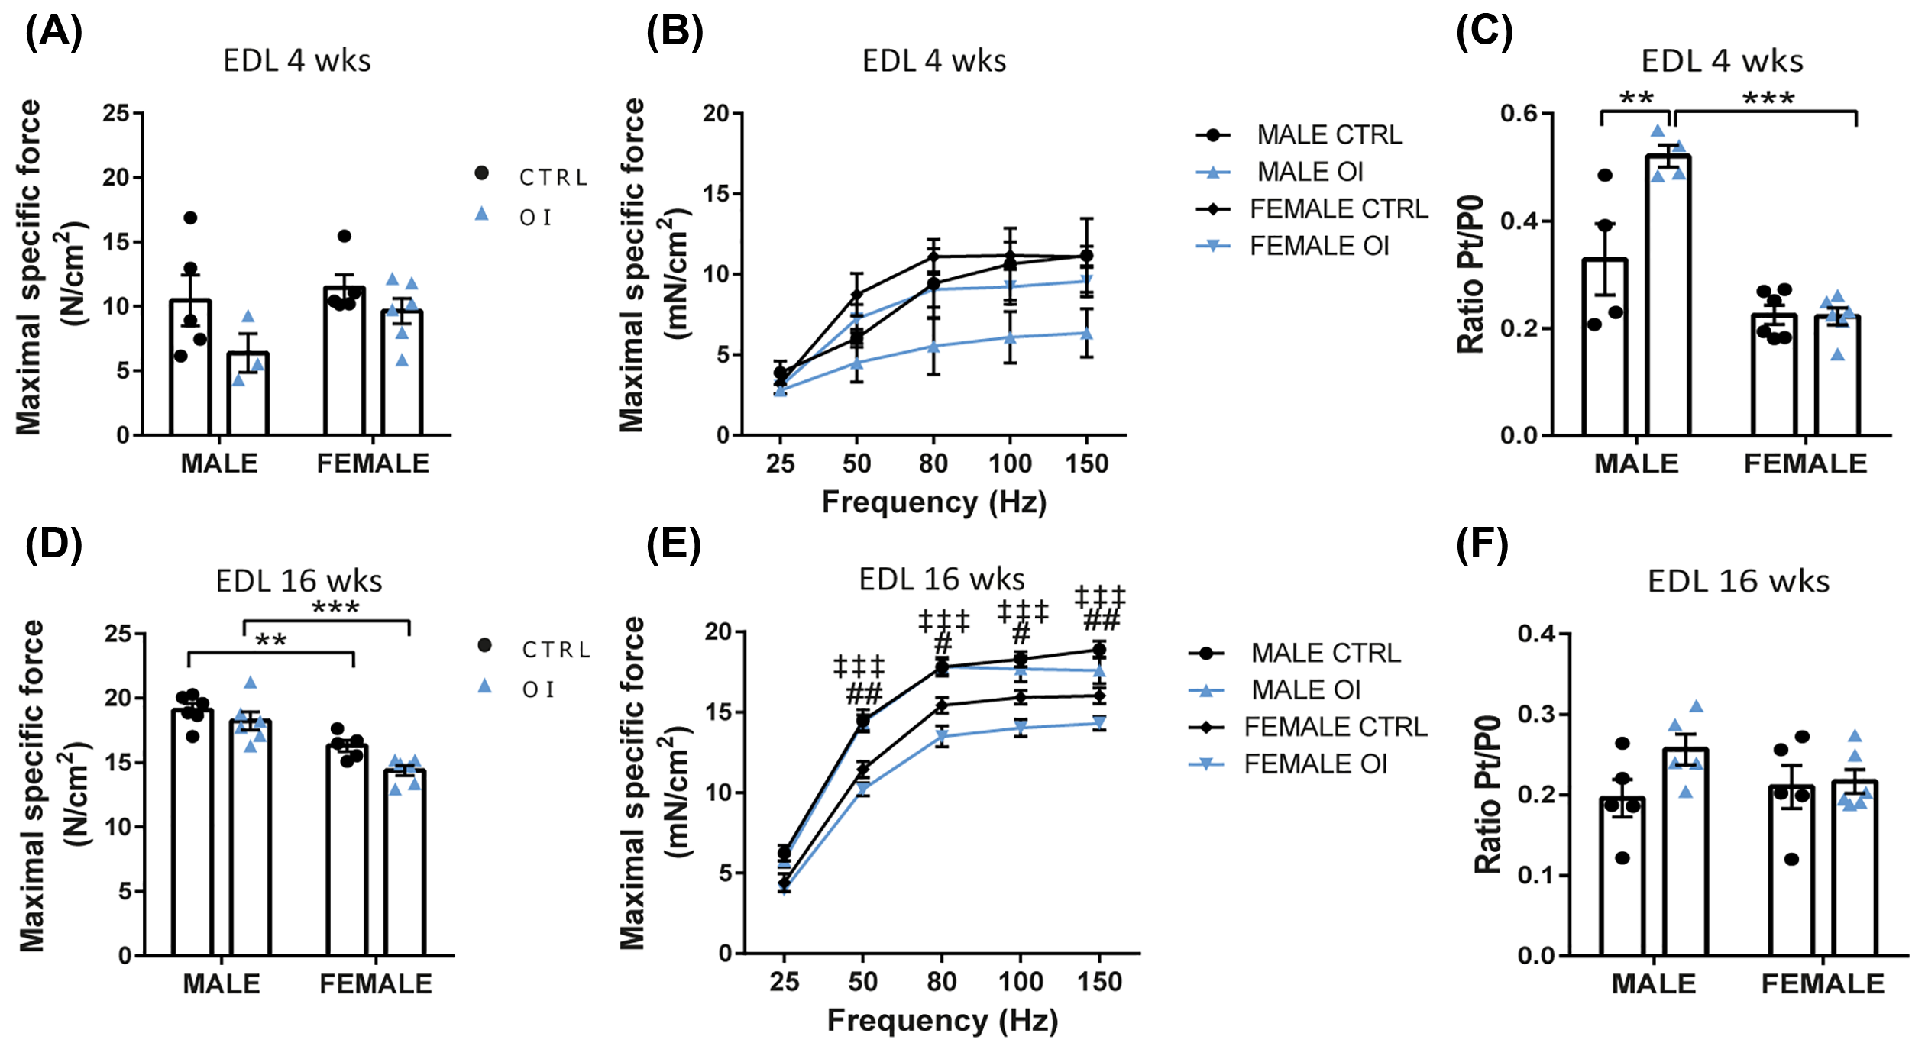
Clin Sci (Lond) Volume 135 Issue 22 2021 2589-2605 10.1042/CS20210894
Figure 7
Transient neonatal exposure to hyperoxia, an experimental model of preterm birth, leads to skeletal muscle atrophy and fiber type switching
The content of this slide may be subject to copyright: please see the slide notes for details
Notes:
Figure Caption:
Muscle contractile properties(A,D) Maximum specific force, (B,E) force–frequency curve, and (C,F) twitch-to-tetanus ratio (Pt/P<sub>0</sub>) of the EDL muscle from 4- (A–C) and 16 weeks (wks) old (D–F) room air control (CTRL) vs neonatal oxygen-induced injury (OI) male and female rats. Error bars represent means ± SEM; n=3–6 per group. Statistical analyses were performed using two-way ANOVA with Tukey’s post-test. *P<0.05; **P<0.01; ***P<0.001 vs group indicated. <sup>#</sup>P<0.05, <sup>##</sup>P<0.01 CTRL males vs CTRL females; <sup>‡‡‡</sup>P<0.001 OI males vs OI females.
Unless stated otherwise in the caption above, the following copyright applies to the content of this slide: © 2021 The Author(s). Published by Portland Press Limited on behalf of the Biochemical Society2021

Slide 8
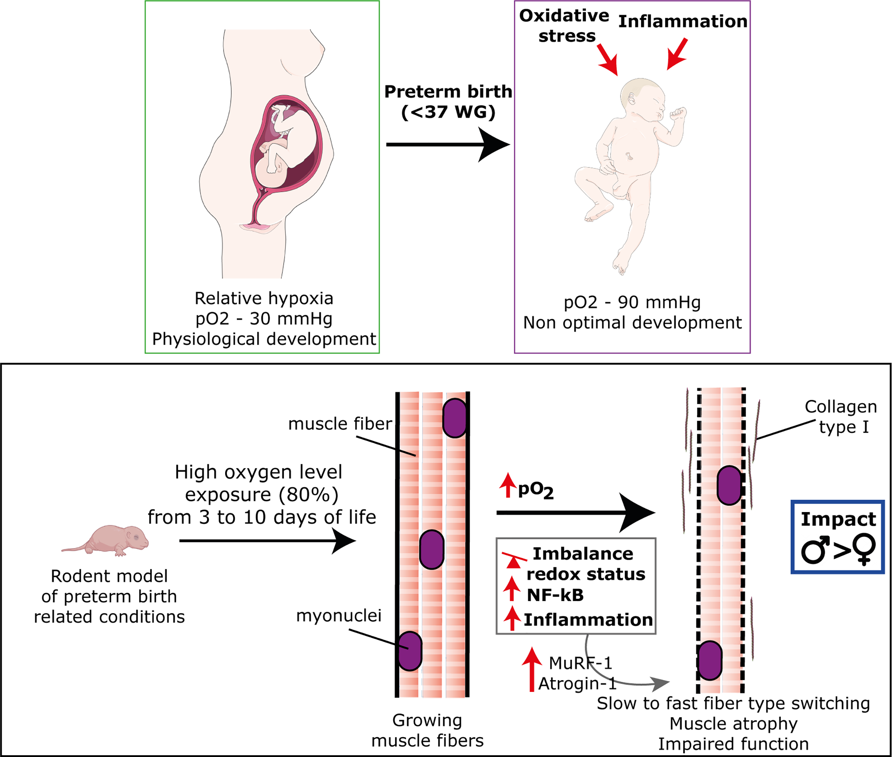
Clin Sci (Lond) Volume 135 Issue 22 2021 2589-2605 10.1042/CS20210894
Figure 8
Transient neonatal exposure to hyperoxia, an experimental model of preterm birth, leads to skeletal muscle atrophy and fiber type switching
The content of this slide may be subject to copyright: please see the slide notes for details
Notes:
Figure Caption:
Schematic overview of the mechanism proposedPreterm newborns are exposed to high levels of oxygen compared with in utero that induce oxidative stress and systemic inflammation in a context of immature tissue development. Using a rodent model of neonatal exposure to hyperoxia, we showed that preterm birth-related condition induced an imbalance in the redox status in skeletal muscles associated with the activation of the key inflammatory pathway NF-κB and chronic inflammatory cell recruitment. These changes were associated with muscle atrophy, fibrosis, fiber type switching (favoring fast-fatigable fibers), and impaired contractile properties. These changes develop overtime and persist until adulthood and are more severe in males than females.
Unless stated otherwise in the caption above, the following copyright applies to the content of this slide: © 2021 The Author(s). Published by Portland Press Limited on behalf of the Biochemical Society2021

