Slide 1

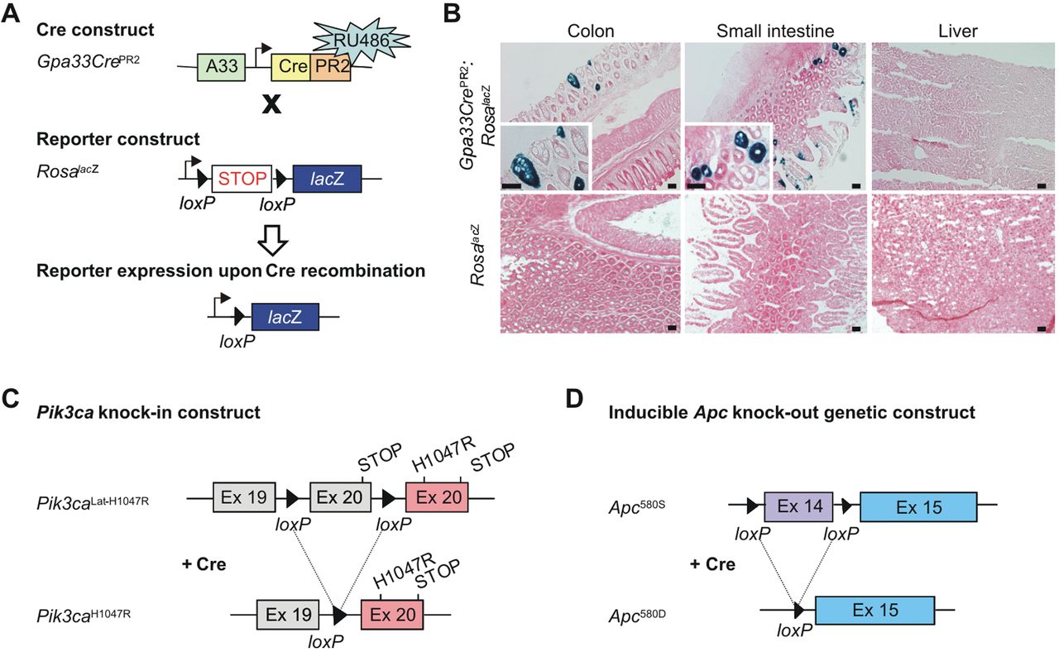
Biochem J Volume 458 Issue 2 2014 251-258 10.1042/BJ20131412
Figure 1
Physiological expression of the PI3K-activating mutation Pik3ca^{H1047R} combines with Apc loss to promote development of invasive intestinal adenocarcinomas in mice
The content of this slide may be subject to copyright: please see the slide notes for details
Notes:
Figure Caption:
Confirmation of Cre excision using the Rosa26<sup>lacZ</sup> reporter mouse(A) Schematic diagram of the genetic strategy used to assess lacZ expression using the lox-stop-lox Rosa26<sup>lacZ</sup> mouse strain crossed with the RU486-inducible Gpa33Cre mouse strain. Upon exposure to RU486, Cre excises the floxed stop codon only in intestinal cells which express Gpa33 resulting in lacZ expression (blue) in these cells which is detectable by β-galactosidase staining. (B) lacZ expression in tissues 90 days post-induction of Cre expression by RU486 from a reporter positive Rosa<sup>lac</sup><sup>Z</sup> (Gpa33Cre<sup>+/−</sup>:Pik3ca<sup>H1047R/WT</sup>:Rosa<sup>lac</sup><sup>Z/WT</sup>) mouse and from a control no Gpa33Cre (Gpa33Cre<sup>−/−</sup>:Pik3ca<sup>H1047R/WT</sup>:Rosa<sup>lac</sup><sup>Z/WT</sup>) mouse. Colon and small intestinal tissues showed positive staining in our test mouse (insert shows a higher magnification) and no staining in the control mouse. Liver was stained as a negative tissue control and showed no positive staining in either the Rosa<sup>lac</sup><sup>Z</sup> reporter or the Gpa33Cre control mice. Scale bars, 50 μm. (C) Schematic of the exon-switch strategy used to engineer a conditional knockin of mutant Pik3ca<sup>H1047R</sup>. LoxP sites were placed on either side of exon 20 of the Pik3ca gene and a duplicate copy of exon 20 containing the mutant sequence (red) placed downstream of the wild-type exon (lat-H1047R). Before Cre exposure the wild-type exon is expressed as normal and only after Cre expression was the floxed wild-type exon excised and replaced by the duplicate exon resulting in expression of the Pi3kca<sup>H1047R</sup> mutation [9]. (D) The Apc conditional knockout mouse strategy used involves the flanking of exon 14 with loxP sites (purple), which is illustrated before (580S) and after (580D) Cre expression [10]. Ex, exon.
Unless stated otherwise in the caption above, the following copyright applies to the content of this slide: © The Authors Journal compilation © 2014 Biochemical Society2014

Slide 2
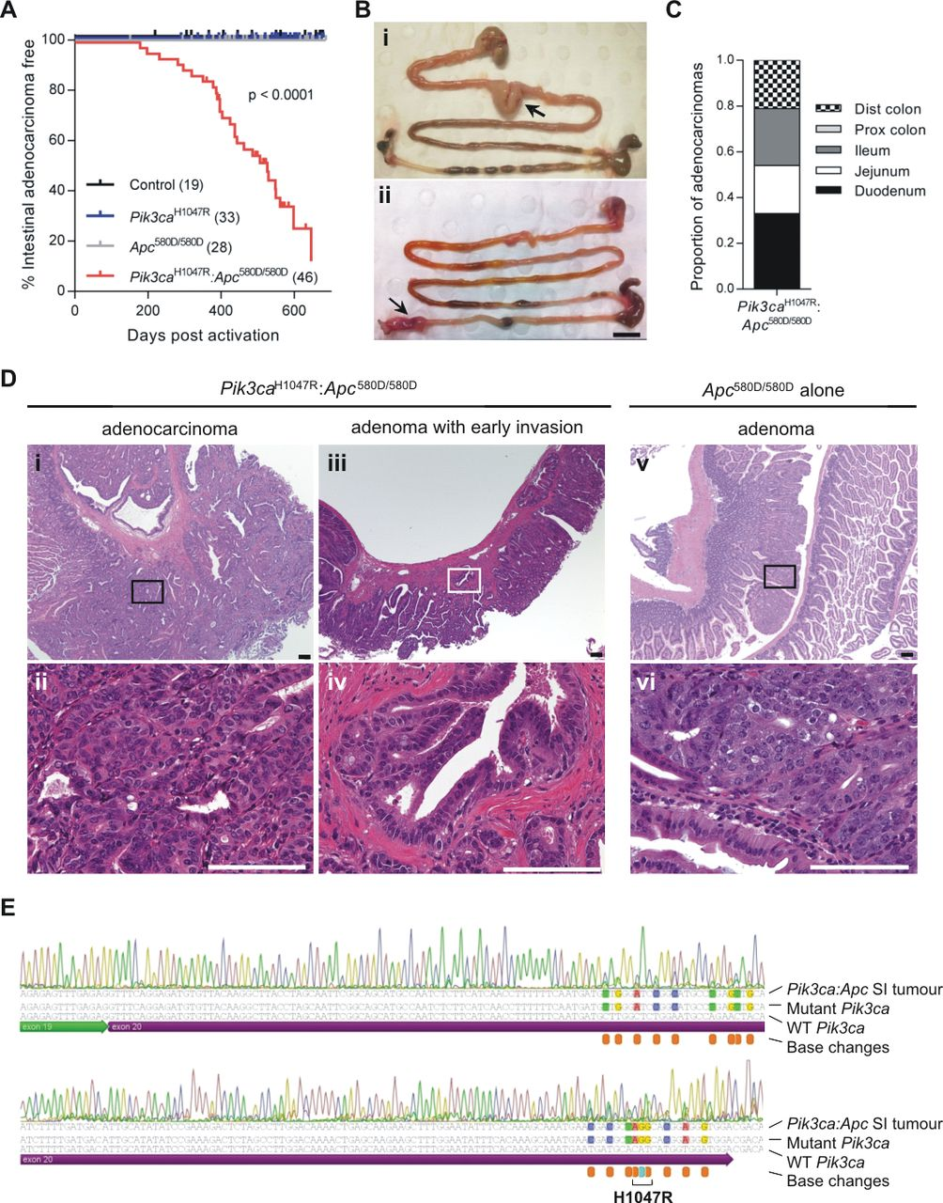
Biochem J Volume 458 Issue 2 2014 251-258 10.1042/BJ20131412
Figure 2
Physiological expression of the PI3K-activating mutation Pik3ca^{H1047R} combines with Apc loss to promote development of invasive intestinal adenocarcinomas in mice
The content of this slide may be subject to copyright: please see the slide notes for details
Notes:
Figure Caption:
Mutant Pik3ca<sup>H1047R</sup> and Apc loss leads to intestinal adenocarcinoma(A) Results are the percentage of mice which were intestinal adenocarcinoma free at the end point for each genotype. Kaplan–Meier analysis reveals a median intestinal tumour-free survival of 506 days in Pik3ca<sup>H1047R</sup>:Apc<sup>580D/580D</sup> mice compared with Apc<sup>580D/580D</sup>, Pik3ca<sup>H1047R</sup> and control mice, all of which remained tumour free (n is given in parentheses). (B) Macroscopic images of large tumours (arrows) observed in both the small (i) and large (ii) intestines of Pik3ca<sup>H1047R</sup>:Apc<sup>580D/580D</sup> mice. Scale bar, 1 cm. (C) Graphical representation of the location proportions of adenocarcinomas observed across the small intestine and colon in Pik3ca<sup>H1047R</sup>:Apc<sup>580D/580D</sup> mice. (D) H/E staining demonstrated that the tumours observed in Pik3ca<sup>H1047R</sup>:Apc<sup>580D/580D</sup> mice were invasive adenocarcinomas. A higher magnification of the boxed area in panel i is shown in panel ii. The additional lesions observed included adenomas with early invasion. A higher magnification of the boxed area in panel iii is shown in panel iv. Apc<sup>580D/580D</sup> mice only presented with adenomas. A higher magnification of the boxed area in panel v is shown in panel vi. Scale bars, 100 μm. (E) RNA was extracted from the tumours, reverse-transcribed into cDNA and Sanger sequenced. Sequencing from exon 19 into exon 20 of the Pik3ca transcript confirmed the introduction of the mutant exon by the presence of all silent base changes engineered into the mutant exon 20 of the mouse [9] (indicated by orange boxes) as well as the base change responsible for the Pik3ca<sup>H1047R</sup> mutation (indicated by the blue box). The portion of sequence spanning the mutation site (labelled H1047R) indicates the A>G base change resulting in the histidine (H) to arginine (R) amino acid change.
Unless stated otherwise in the caption above, the following copyright applies to the content of this slide: © The Authors Journal compilation © 2014 Biochemical Society2014

Slide 3
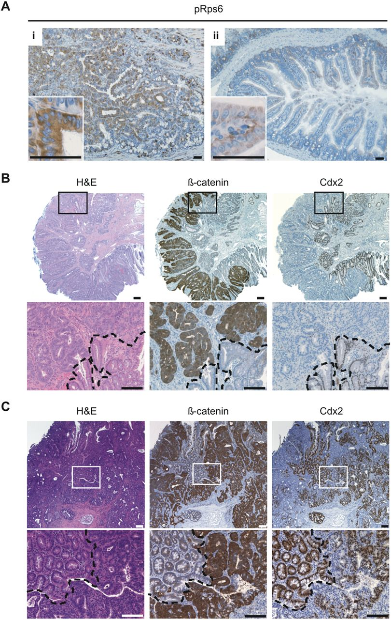
Biochem J Volume 458 Issue 2 2014 251-258 10.1042/BJ20131412
Figure 3
Physiological expression of the PI3K-activating mutation Pik3ca^{H1047R} combines with Apc loss to promote development of invasive intestinal adenocarcinomas in mice
The content of this slide may be subject to copyright: please see the slide notes for details
Notes:
Figure Caption:
Intestinal adenocarcinomas from Pik3ca<sup>H1047R</sup>:Apc<sup>580D/580D</sup> mice show high PI3K and β-catenin signallingRepresentative histological images and IHC staining of adenocarcinomas observed in the small intestine and colon of Pik3ca<sup>H1047R</sup>:Apc<sup>580D/580D</sup> mice. (A) Staining for phospho-RPS6 in an invasive adenocarcinoma (i) and the adjacent normal small intestine (ii) (higher resolution images are shown in the inserts). Colon (B) and small intestine (C) adenocarcinomas were stained for β-catenin to evaluate the loss of Apc activity and Cdx2, an intestinal cell marker, was used to demonstrate the intestinal origin of the tumours. The boxed areas are shown at a higher resolution below each image. Areas which stained differentially for β-catenin and Cdx2 are separated by a broken line. Scale bars, 100 μm.
Unless stated otherwise in the caption above, the following copyright applies to the content of this slide: © The Authors Journal compilation © 2014 Biochemical Society2014

Slide 4
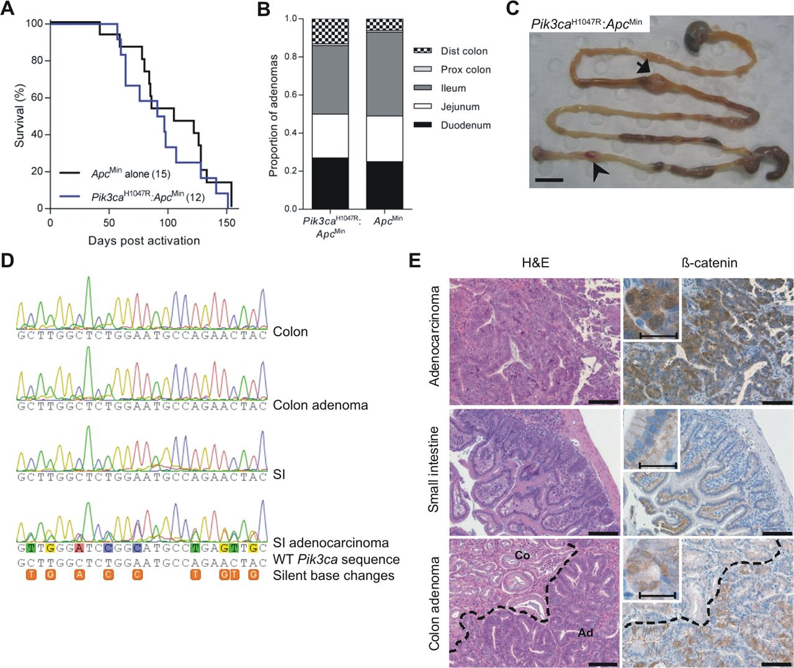
Biochem J Volume 458 Issue 2 2014 251-258 10.1042/BJ20131412
Figure 4
Physiological expression of the PI3K-activating mutation Pik3ca^{H1047R} combines with Apc loss to promote development of invasive intestinal adenocarcinomas in mice
The content of this slide may be subject to copyright: please see the slide notes for details
Notes:
Figure Caption:
An intestinal adenocarcinoma was observed in a single Pik3ca<sup>H1047R</sup>:Apc<sup>Min</sup> mouse(A) Kaplan–Meier curve of survival in a cohort of control Apc<sup>Min</sup> alone (Gpa33Cre<sup>+/−</sup>:Apc<sup>Min/WT</sup>) mice compared with a cohort of mutant Pik3ca<sup>H1047R</sup>:Apc<sup>Min</sup> (Gpa33Cre<sup>+/−</sup>:Pik3ca<sup>H1047R/WT</sup>:Apc<sup>Min/WT</sup>) mice (the n is shown in parentheses). (B) Graphical representation of the proportion of adenomas observed across the small intestine and colon of Pik3ca<sup>H1047R</sup>:Apc<sup>Min</sup> and Apc<sup>Min</sup> alone mice. (C) Upon dissection of the gastrointestinal tract, a large polyp was observed in the jejunum of the small intestine (arrow). A smaller polyp was observed in the colon (arrow head). Scale bar, 1 cm. (D) RNA was extracted from polyps as well as normal colon and small intestine (SI) tissue. The RNA was reverse-transcribed to cDNA and Sanger sequenced for the Pik3ca<sup>H1047R</sup> mutation. The wild-type Pik3ca gene (WT Pik3ca) sequence is shown as well as the silent base changes engineered into the mutant Pik3ca<sup>H1047R</sup> which are identified by the orange boxes. (E) Pathological analysis of H/E sections from these polyps revealed that the jejunum growth was an invasive adenocarcinoma, whereas the colon polyp was an adenoma. IHC staining for β-catenin of FFPE (formalin-fixed paraffin-embedded) sections of these tumours or adenomas was conducted to confirm the loss of Apc activity (a higher magnification image is shown in the insert). The broken line separates area of normal colon (Co) from the adenoma (Ad). Scale bars: bracketed, 25 μm and unbracketed, 100 μm.
Unless stated otherwise in the caption above, the following copyright applies to the content of this slide: © The Authors Journal compilation © 2014 Biochemical Society2014

