Slide 1

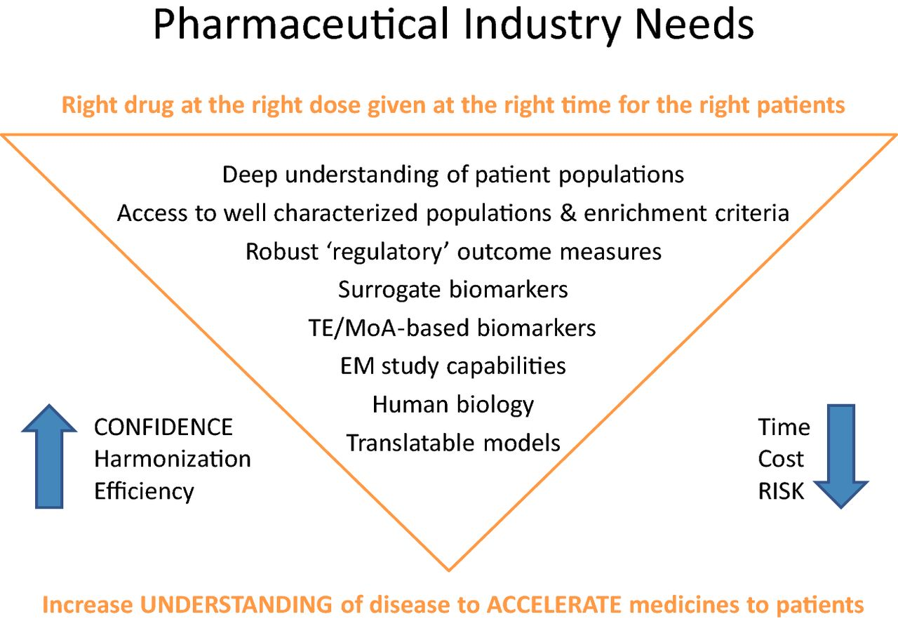
Clin Sci (Lond) Volume 131 Issue 9 2017 799-802 10.1042/CS20160724
Figure 1
Mechanisms of vascular disease in dementia: what does industry want to know?
The content of this slide may be subject to copyright: please see the slide notes for details
Notes:
Figure Caption:
Schematic representation of industry needs to facilitate drug development in VaD/VCIAs the layers of information build, this produces increasing confidence in the ability to run clinical programs in well-defined clinical populations, with the right drug and dosing strategy (i.e. the right drug at the right dose at the right time for the right patients). Bringing the triangular factors together within consortia or a pre-competitive environment can increase harmonization and confidence, and drive efficiencies in time, cost and risks (scientific, patient and strategic) to create a focused path from deep understanding of disease to medicines; MoA, mechanism of action.
Unless stated otherwise in the caption above, the following copyright applies to the content of this slide: © 2017 The Author(s); published by Portland Press Limited on behalf of the Biochemical Society2017

